Slide 1
The main parts of a computer
The main parts of a computer, whether it is a desktop computer, a mobile phone or your digital clock are:
  Central Processing Unit (CPU)
      This is the “brains” of the computer where all the calculations take place.
  Main memory
      This is where the computer stores the information that the CPU uses.
  Input/Output devices (I/O devices)
      These are all the devices that the user interacts with;
      the keyboard, display, communication devices (wired and wireless), hard disk, DVD drive, etc.

Slide 2
System bus
The main parts of the computer are connected by the system bus.
system clock
CPU
interrupt request
Main memory
I/O devices

Slide 3
System bus (2)
The system bus contains 3 buses
  Address bus
      Each main memory location and each I/O device has its own address
      we can differentiate between different memory locations and I/O devices.
  Data bus
      Carries data between
        CPU, main memory and I/O devices.
        data flows between the CPU and main memory, or between the CPU and the I/O devices.
  Control bus
      Consists of special signals, mainly to synchronise the address bus and data bus.

Slide 4
Address bus
Each location in memory has a unique address.
The size of the address bus determines the maximum number of memory locations that the CPU can access.
  A 3-bit address bus would have 3 signals, A0, A1 and A2.
    The maximum number of different addresses for a 3-bit address bus is 2³=8 (i.e. 000,001,010,011,100,101,110,111)
  A 16-bit address bus has 2¹⁶ (=65,536) different addresses.
  A 32-bit address bus has 2³² (=4,294,967,296) different addresses.
The bigger the address bus the more memory that the CPU can access.
  But more signals are need! Harder to manufacture.

Slide 5
Data bus
The data bus carries data from one device to another.
Generally the CPU is involved.
    From main memory to the CPU.
    From CPU to main memory.
    From I/O device to CPU
    From CPU to I/O device.
An 8-bit data bus can represent numbers from 0 to 255.
  If the calculations require numbers greater than 255, then the calculations is done in 8-bit units.
hexidecimal
1425
0x0591
00000101
10010001
carry
6079
0x17BF
00010111
10111111
+
+
+
+
7504
0x1D50
00011101
01010000

Slide 6
Control bus
The control bus
  contains signals
  used to synchronise the transfer data to and from the CPU.
It contains:
    Signals that say when the address bus is valid.
    Signals that control whether data is read from or written to a memory location or I/O device.
    Interrupt Signals (requests and acknowledgements)
    Reset and timing signals.

Slide 7
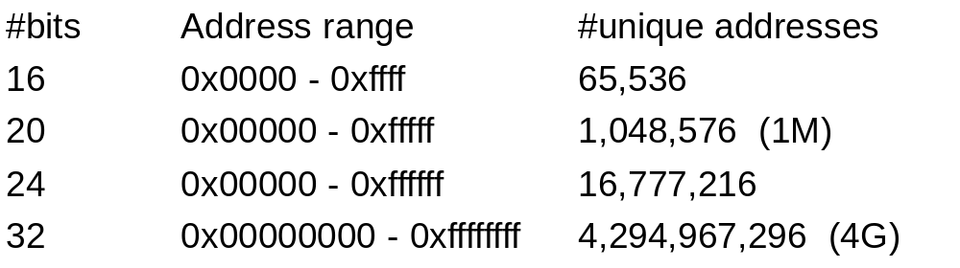
Main memory
Each memory location has a unique address.
The number of unique addresses is determined by the size of the address bus.
Each memory location contains a 8-bit (byte) value.
A 16-bit data bus requires 2 bytes of data.
  Each 16-bit data value is at an even address.
Main memory contains the program and its data.

Slide 8
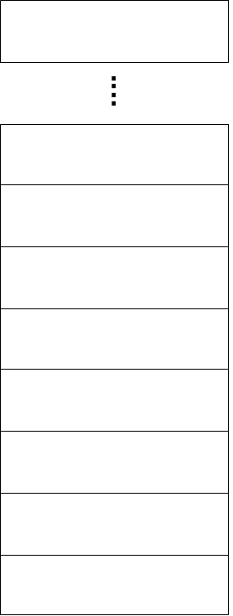
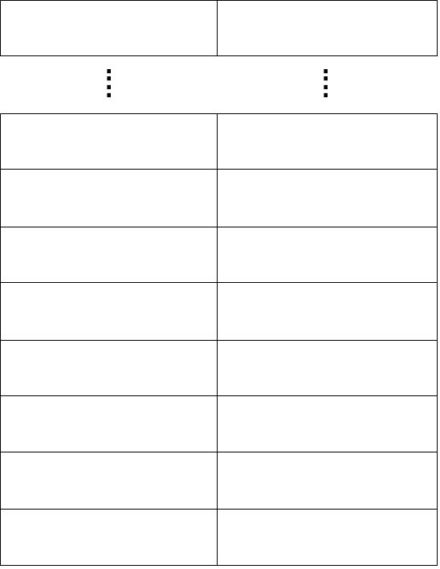
Main memory (2)
16-bit address bus
and an 8-bit data bus
16-bit address bus
and a 16-bit data bus
0xffff
0xfffe
0x0007
0x000e
0x0006
0x000c
0x0005
0x000a
0x0004
0x0008
0x0003
0x0006
0x0002
0x0004
0x0001
0x0002
0x0000
0x0000

Slide 9
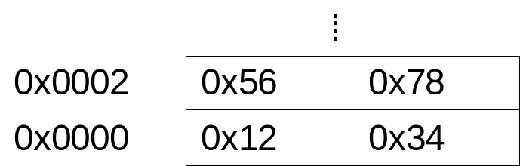
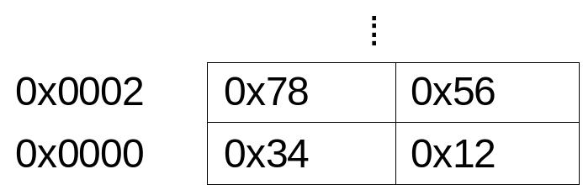
Big-endian and Little-endian
With a 16-bit data bus, the order is which the 2 bytes that form the 16-bit word can either be:
  Big-endian
    Most-significant (MS) byte first then least-significant (LS) byte next.
    Convention adopted by Motorola
  Little-endian
    Least-significant (LS) byte first then most-significant (MS) byte next.
    Convention adopted by Intel
The first 2 locations contain
0x1234 and 0x5678
big-endian
little-endian
What happens if data is transferred from an Intel-based machine to a Motorola-based machine?

Slide 10
The CPU
Modern central processor units (CPUs) consist of 4 major subsystems.
  Control Unit
    This subsystem controls the executing of the CPU.
  Arithmetic Logic Unit (ALU)
    This subsystem performs the arithmetic and logical operations.
  Registers
    Local, and very high speed, memory that includes the status flag register.
  Cache
    Specialised high speed memory

Slide 11
Control Unit
The Control Unit (CU) controls the operation of the CPU, and in particular, the fetch-decode-execute cycle.
  Fetch
    Retrieve the next instruction to execute.
  Decode
    Decode the instruction and set-up the necessary data paths to allow the execution of the instruction.
  Execute
    Execute the instruction.

Slide 12
Control Unit (2)
There are 2 special registers in the CPU that are involved in the fetch operation.
  The Instruction Pointer (IP)
    Also known as the Program Counter (PC).
    A register that contains the address of the memory location that contains the next instruction to execute.
    The IP register is large enough to reference any address in the memory.
  The Instruction Register
    During the fetch operation the next instruction to execute is copied into the Instruction Register.

Slide 13
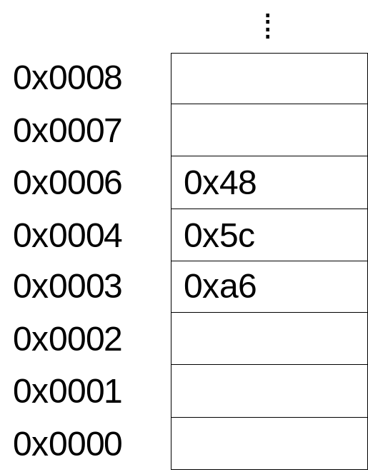
Control Unit (3)
Data Bus
0x0004
0x0004
IP
0x5c
IR
0x5c
CPU
Address Bus

Slide 14
Control Unit (4)
An instruction is made up of an operation code (opcode) and an arbitrary number of operands.
  In the x86 processors the instruction add AL,#01 is stored as 0x04 0x01 in memory
Once the opcode is loaded in to the IR, it is decoded.
  Sets up the data paths between the registers, ALU and memory.
  The decoding is highly dependent on the internal structure of the CPU.
Opcode for add AL,#
Operand

Slide 15
Control Unit (5)
CISC (Complex Instruction Set Computer)
  each instruction has its own little program to execute it.
  program is called microcode
  stored internally in the CPU.
RISC (Reduced Instruction Set Computer)
  each instruction is typically
    larger
    encodes all the information required to execute the instruction.
  control unit is typically busier than a CISC system.

Slide 16
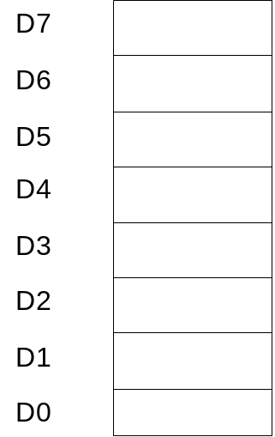
ALU
The Arithmetic Logic Unit (ALU) performs the arithmetic and logical operations as determined by the Control Unit.
data registers
Internal data bus
A
B
carry in
CU
ALU
control lines
CPU flags
control lines
C

Slide 17
Registers
Registers are local memory that is connected to the CPU's internal data bus.
  Accessing data in a register is significantly faster than accessing data in main memory because:
    There is no need to put an address on the system address bus before reading the data.
    The CPU's internal data bus is faster than the external system data bus.
Different CPUs have a different number of registers and different sizes of registers.
Some registers are general purpose and some have specific purposes.

Slide 18
Registers (2)
Some special purpose registers:
  Accumulator
    On older CPUs
      directly connected to the ALU and arithmetic or logical operations involving the accumulator where faster than other registers.
    On modern CPUs
      the accumulator is still faster for some specialised operations.
  Index Registers
    Contain the address of a memory location
    can be used to read or write to that location.
    fast increment and decrement operations.

Slide 19
Registers (3)
  Flag Register
    The individual bits in this register are typically updated by the ALU to reflect to result of the most recent operation.
    Carry Flag
      The Carry Flag is set to 1 if an ALU operation results in a carry out from the MS bit, else it is 0.
    Sign Flag
      The Sign Flag is set to 1 if the MS bit is 1, else it is 0.
Overflow Flag
Sign Flag
Zero Flag
Carry Flag

Slide 20
Registers (4)
Zero Flag
  The Zero Flag is set to 1 if the ALU operation resulted in ZERO, else it is 0.
Overflow Flag
  This Overflow Flag is set to 1
    if the addition of 2 positive numbers results in a negative number
    or the addition of 2 negative numbers results in a positive number
  Else it is 0.

Slide 21
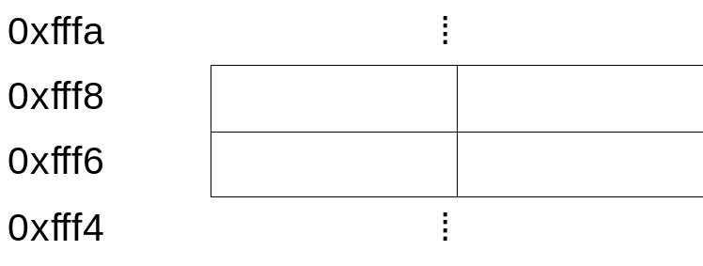


Registers (5)
  Stack Pointer (SP)
    This register holds the address of the next vacant location in the stack.
    The stack is an area of main memory that is primarily used to hold the the return addresses from subroutine calls.
    CALL and RETURN instructions automatically update the stack and the stack pointer.
mov AX,time
call timer
mov AX,result
⁞
timer:
⁞
call system_clock
add AX,BX
⁞
return
system_clock:
⁞
return
0xfff8
Before call timer

Slide 22
Registers (6)
mov AX,time
call timer
mov AX,result
⁞
timer:
⁞
call system_clock
add AX,BX
⁞
return
system_clock:
⁞
return
Address of mov AX,result
0xfff6
After call timer
mov AX,time
call timer
mov AX,result
⁞
timer:
⁞
call system_clock
add AX,BX
⁞
return
system_clock:
⁞
return
Address of mov AX,result
Address of add AX,BX
0xfff4
After call system_clock

Slide 23
Registers (7)
mov AX,time
call timer
mov AX,result
⁞
timer:
⁞
call system_clock
add AX,BX
⁞
return
system_clock:
⁞
return
Address of mov AX,result
0xfff6
After return in system_clock
mov AX,time
call timer
mov AX,result
⁞
timer:
⁞
call system_clock
add AX,BX
⁞
return
system_clock:
⁞
return
0xfff8
After return in timer

Slide 24
Cache
Programs have loops, even machine code programs.
Good programs have small functions.
This gives rise to two affects.
  Any instruction that is about to be executed was most likely executed recently.
  Any memory location to be accessed was most likely accessed recently.
Since accessing main memory is slower than memory in the CPU it would be more efficient to keep a copy recently execute instructions and accessed memory in the CPU.

Slide 25
Cache (2)
A Cache is specialised memory for storing recently executed instructions and accessed memory.
  On-chip cache (level 1 cache) is built into the CPU and is connected to the CPU's internal data bus.
  Level 2 cache is not in the CPU but is high speed memory located close to the CPU.
Cache memory is smaller than main memory and it only holds a copy of a fraction of main memory.
  The most recently used fraction.
Cache memory is organised differently to main memory. Rather than being a linear collection of memory locations, it is a pool of memory locations.
  Each entry in the cache has a tag and data value.

Slide 26
Cache (3)
When an instruction or data value is to fetched, its address is used to calculate a tag.
The cache is searched for an entry with a matching tag.
If a matching tag is found
  cache hit
  data attached to the tag is returned.
If a matching tag is not found
  cache miss and main memory is accessed.
  The data from main memory is then added to the cache along with its tag.

Slide 27
Cache (4)
A cache is designed to enable an efficient search for tags in order to determine if there is a cache hit or cache miss without searching the whole cache.
A cache is determined by:
  Its size.
  How it is organised.
  A replacement policy: When a cache is full and a new entry is added, which value do we lose. The oldest? The least used?
  A write policy: If a data value is modified in the cache, is the main memory updated immediately (write-through) or when the entry corresponding to the data value is removed from the cache (write-back)?

